Slide 1
Ethiopia: Gross Violations of Human Rights and an Intractable conflict
Presenter: Garoma B. Wakessa (Mr.),
Director, the Human Rights League of the Horn of Africa (HRLHA)
Toronto, Canada
Presented on 26th Oromo Studies Association (OSA)
August 01, 2015
hhttp/humanrightsleague.org
hrldirector@mail.org or admin@humanrightleague.org
HRLHA
March 2015

Slide 2
Gross Violations of Human Rights
Presentation Overview
Human Rights and Civil Rights
Protection and Promotion of Human Rights
What it Means to Violate Human Rights
Conflicts and Intractable Conflicts
Causes of Intractability
Various types of Human Rights Violations and Intractable Conflict, the case of the Horn of Africa/Ethiopia
Democracy as façade for repression in Ethiopia

Slide 3
Gross Violations of Human Rights
Human Rights:
Human rights are basic rights and freedoms that all people are entitled to regardless of nationality, sex, national or ethnic origin, race, religion, language, or other status
Human rights are universal
Human rights are the articulation of the need for justice, tolerance, mutual respect and human dignity
Civil Rights :
Civil rights, on the other hand, are those rights one enjoys by virtue of citizenship in a particular nation or state.
Civil rights get the protection of the Constitution.
Civil rights protect citizens from discrimination and grant certain freedoms, like free speech, due process, equal protection, the right against self-incrimination, and so forth.
Civil rights can be thought as the agreement between the nation, the state, and the individual citizens that they govern.

Slide 4
Protection and Promotion of Human Rights
To protect human rights is to ensure that people receive some degree of decent, human treatment
Everyone has the right, individually and in association with others, to promote and to strive for the protection and realization of human rights and fundamental freedoms at the national and international levels (Article 1)
Each State has a prime responsibility and duty to protect, promote and implement all human rights and fundamental freedoms (Article 2)

Slide 5
Human Rights violations and Conflict
Abuse of human rights often leads to conflict, and conflict typically results in human rights violations
It is not surprising, then, that human rights abuses are often at the center of wars and that protection of human rights is central to conflict resolution.
Violations of political and economic rights are the root causes of many crises
When the rights to adequate food, housing, employment, and cultural life are denied, and large groups of people are excluded from the society's decision-making processes, there is likely to be great social unrest
Indeed, many conflicts are sparked or spread by violations of human rights
For example, massacres or torture may inflame hatred and strengthen an adversary's determination to continue fighting. Violations may also lead to further violence from the other side and can contribute to a conflict spiraling out of control.

Slide 6
Human Rights violations and Conflict
Human rights violation is to deny individuals fundamental moral entitlements
Treat them as if they are less than human and undeserving of respect and dignity
What is Conflict?
Conflict usually occurs primarily as a result of a clash of interests in the relationship between parties, groups, or states. Because they pursue opposing or incompatible goals
Conflicts could be miner, major and intractable.
Sources of Conflicts:
There are various reasons for conflicts
Conflict between two states (Boundary conflict)
Internal conflicts (conflict between ethnic groups, conflict between government and population due to human rights abuses)

Slide 7
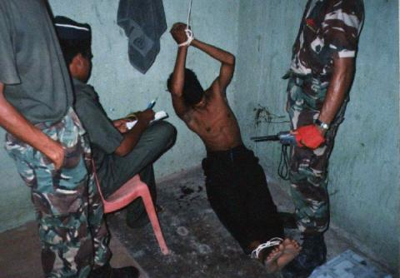
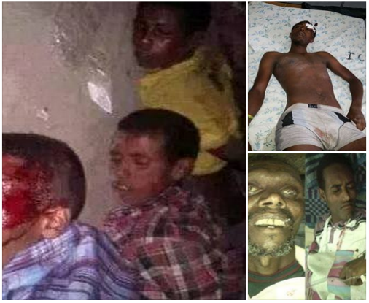
Ethiopia: Gross Human Rights Abuses Against Oromo Nation (1991 –Present)
Overview
Contents
Imprisonment
Disappearances
Torture & Killings
Breaching of Domestic and
International obligations
Western aid Money’s Adverse Role
Genocide & Crime against Humanity (Rome Statute)
Accountability

Slide 8
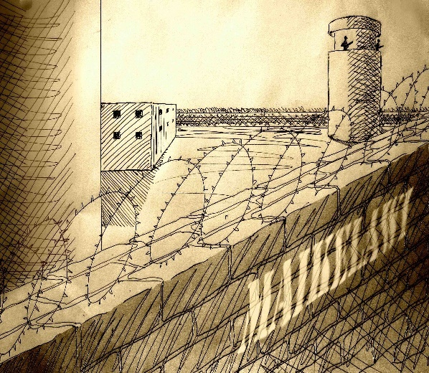
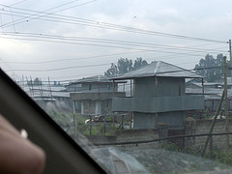
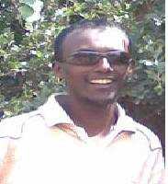
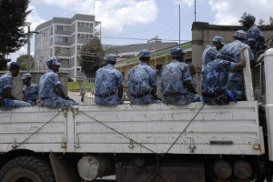
Prisoners in Ethiopia
Ethiopian Prisoners
Registered | 93,044
Unregistered | 54,000
Total | 147,041
Taye Danda’a
Oromo Prisoners
Maikelawi Prison
Registered | 45,000
Unregistered | 39,500
Total | 84,500
Kaliti Prison
Student Seenaa Mararaa
Meki Prison

Slide 9
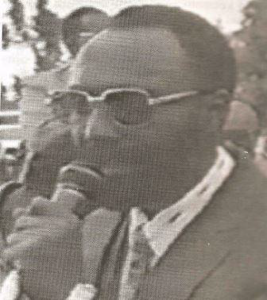
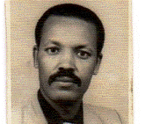
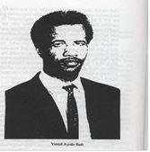
Disappearances
Starting from 1991 to present more than 2,000 Oromos were disappeared. Among them 1, 050 are registered
J/Nadhii Gamadaa 1994
Bantii Gudataa Hirphaa
1998
Yoosef Ayelee Baatii
1992

Slide 10
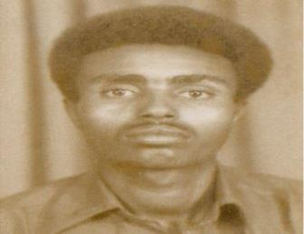
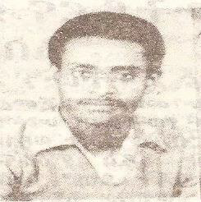
Disappearances…
Musxafaa Idiris
1994
Kaasaahuun Habtee
1996
Jireenyaa Ayyaanaa
1995

Slide 11
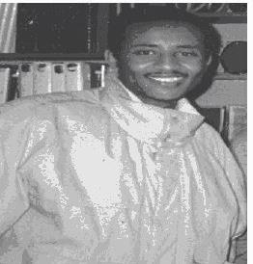
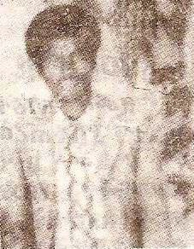
Disappearance. . .
Jamaal Huseen
1994
Baqqalaa Daawanoo
1993
Tamasgeen Adabaa
1995

Slide 12
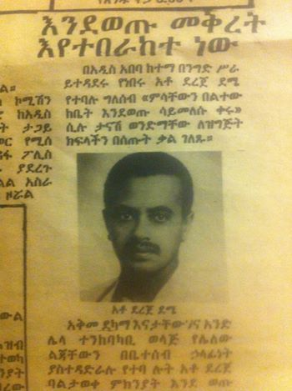
Disappearance. . .
Saadiq Umar
1994
Lammeessaa Boruu
1992
Derejjee Damee
1994

Slide 13
3. Oromo Tortured and Killed (1991- 2014)
Oromo | # of Victims
Tortured | 7000+
Killed | 3,550+
Torture and Killing Centers
Maikelawwi
Military camps
Public offices
Residential buildings (Basement)
Prison Camps
Torturers and Killers
Security forces
Soldiers
Intelligence officers
Prison guards

Slide 14
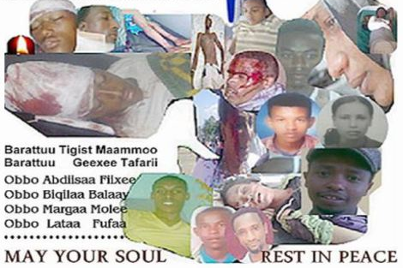
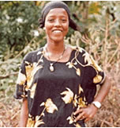
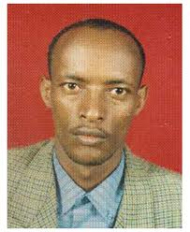
Tortured and Killed. . .
Aisha Ali, 14
Tasfahun Chemeda

Slide 15
Tortured and Killed. . .
Common Torturing Methods
Searing with hot irons,
Burning at the stake,
Electric shock treatment to the genitals,
Cutting out parts of the body, e.g. entrails or genitals,
Severe beatings,
Suspending by the legs with arms tied behind the back, etc..
All of these practices presuppose that the torturer has control over the victim's body.

Slide 16
Breach of Domestic Constitution, Regional & International HR Treaties & International Law
Ethiopian Constitution of 1995
African Peoples’ and Human Rights Treaty of 1981
International Human Rights Treaties (Treaty law)
International Law (Human Rights Treaties and Customary Law)

Slide 17
Breach of Ethiopian Constitution
Ethiopian Constitution 1995,
CHAPTER THREE, FUNDAMENTAL RIGHTS AND FREEDOMS
Article 14, Rights to life, the Security of Person and Liberty
Article 15, Right to Life
Article 16, The Right of the Security of Person
Article 17, Right to Liberty
Article 18, Prohibition against Inhuman Treatment
Article 27, Freedom of Religion, Belief and Opinion
Article 28, Crimes Against Humanity
Article 29, Right of Thought, Opinion and Expression
Article 30, The Right of Assembly, Demonstration and Petition

Slide 18
Breach of African Charter on Human and Peoples’ Rights
Article 11, Every individual shall have the right to assemble freely with others
Article 20, 1. All peoples shall have the right to exist.
They shall have the unquestionable and an inalienable right to self- determination.
They shall freely determine their political status and shall pursue their economic and social development, according to the policy they have freely chosen.
Article 22, 1. All peoples shall have the right to their economic, social and cultural development with due regard to their freedom and identity and in the equal enjoyment of the common heritage of mankind.

Slide 19
International Human Rights Treaties signed & Ratified by Ethiopian Government (Treaty Law)
No | Documents | Year
1 | Convention Against Torture and Other Cruel, Inhuman or Degrading Treatment or Punishment | 1994
2 | International Covenants on civil and political rights (ICCPR) | 1993
3 | International Covenants on Economic, Social and Cultural Rights (ICESCR) . | 1993
4 | Convention on the Rights of the Child (CRC) | 1991

Slide 20
Breach of International Human Rights Treaties . . .
No | Documents | Year
5 | Convention on the Elimination of All Forms of Discrimination against Women (CEDAW) | 1981
6 | International Convention on the Elimination of All Forms of Racial Discrimination (ICERD) | 1976
7 | Convention on the Prevention and Punishment of the Crime of Genocide | 1948

Slide 21
Ethiopian Government Obligations
A State/Ethiopia is bound to act in accordance with
(a) Domestic law of the State/Ethiopia
(b) International Treaties to which a State/it is a party
(C) Public international law
These are fundamentals principle in international law called “pacta sunt servanda” (Latin, agreements must be respected)

Slide 22
The Scope of the obligation
obligation to respect, and implement international human rights law
Take appropriate legislative Human Rights law and international humanitarian law
Take appropriate legislative and administrative and other appropriate measures to prevent violations,

Slide 23
The Scope . . .
Investigate violation effectively, promptly , thoroughly, impartially, and take action against those responsible.
Provide those who claim to be victims of a human rights or humanitarian law violation with equal and effective access to justice
Provide effective remedies to victims, including reparation,

Slide 24
When Does a State Violates Treaties And International Laws?
A state violates Treaties & international law when it commits an “internationally wrongful act", which breaches an international obligation that the state was bound by at the time when the act took place.
Or a state can be considered having committed a violation if an action by an individual can be attributable (connected) to the state.

Slide 25
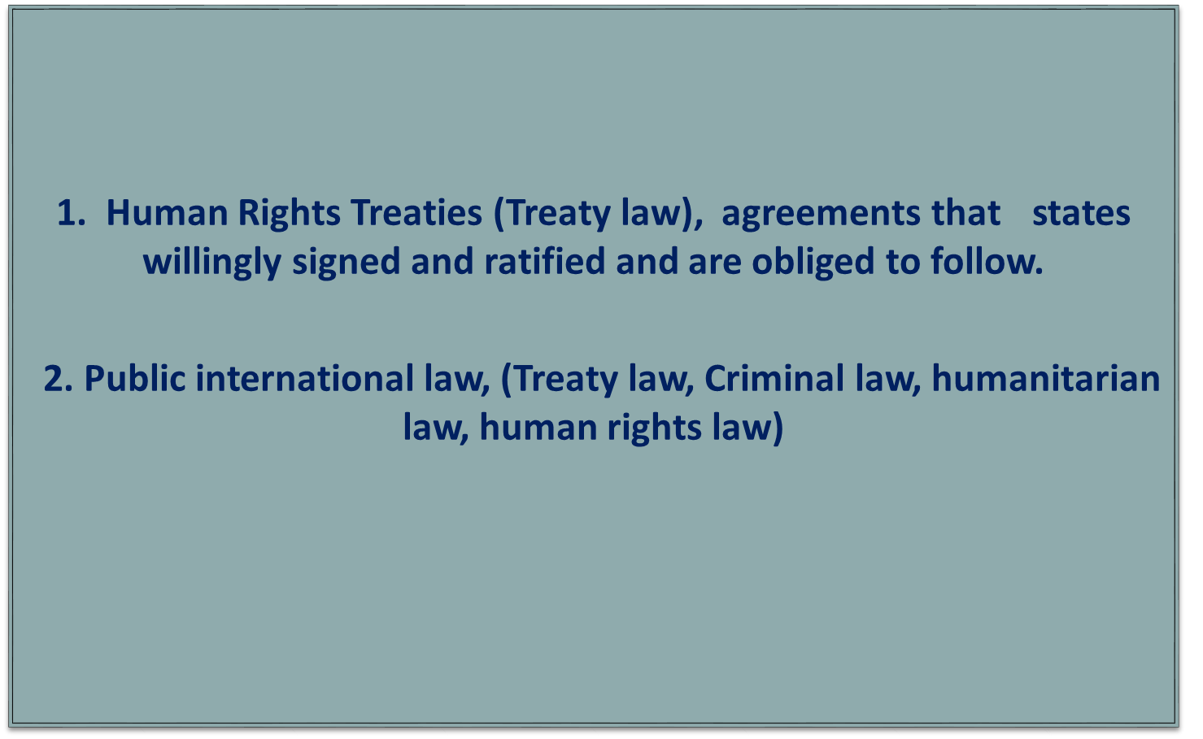
The Accountability of a state for violating Human Rights
Ethiopian Government is accountable for committing human rights violation, under

Slide 26
WHAT IS GENOCIDE??
“Any of the following acts committed with intent to destroy, in whole or in part, a national, ethnic, racial or religious group, as such”
1. Killing members of the group.
2. Causing serious bodily or mental harm.
3. Deliberately inflicting conditions of life
for physical destruction in whole or in part.
4. Imposing measures intended to prevent births within the group
5. forcibly transferring children of the group to another group."
Rome Statute
Of the International
Criminal Court, Article 6
July 1998

Slide 27
What is Crime Against Humanity ??
“Crime against humanity” means any of the acts when committed as a part of widespread or systematic attack directed against any civilian population, with the knowledge of the attack
Murder, (b) Extermination, (c) Enslavement
(d) Deportation or forcible transfer of population and imprisonment or other severe deprivation of physical liberty in violation of fundamental rules of International law
(f) Torture
(g) Rape (Sexual abuse)
Rome Statute
Of the International
Criminal Court, Article 6, July 1998

Slide 28
The Accountability of the State . . .
The Atrocity committed by Ethiopian Government against Oromo Nation Falls Under Which Category
Genocide ?
Crime against humanity ?

Slide 29
At What Extent Ethiopian Government Could be Accountable for its Wrong Acts ?
Ethiopian Constitution 1995,
Article 28 Crimes Against Humanity
II. African on Human and Peoples Right
III. Human Rights Treaty Law
IV. Public International Law

Slide 30
Holding the Perpetrators Accountable
Mandate-holder courts to see Human Rights cases
Federal Supreme Court of Ethiopia
African Court on Human and Peoples' Rights
International Criminal Court (ICC)

Slide 31
Bringing Cases Before the Court
The Court | Mandates of the Court | Who can refer the Case to the Court? | Possibility
Federal Supreme Court of Ethiopia | All Criminal Cases | Ethiopia Citizens | ?
African Court on Human and Peoples Right | All Human Rights Issues | Member States, Groups With Observer status Individuals | Yes
International Criminal Court (ICC) | Crime of Genocide War Crime Crime Against Humanity Crime of Aggression | Member States UN Security Council Non-Governmental Organizations Individuals | Yes

Slide 32
END

Slide 33
International Covenants and Conventions (International Human Rights Treaties)
1. The Convention on the Elimination of All Forms of Racial Discrimination
2. The International Covenant on Civil and Political Rights
The Optional Protocol to the International Covenant on Civil and Political Rights
The Second Optional Protocol to the International Covenant on Civil and Political Rights
3. The International Covenant on Economic, Social and Cultural Rights
Optional Protocol to the International Covenant on Economic, Social and Cultural Rights
4. The Convention on the Elimination of All Forms of Discrimination Against Women
Optional Protocol to the Convention on the Elimination of All Forms of Discrimination Against Women
5. The Convention Against Torture, and Other Cruel, Inhuman or Degrading Treatment or Punishment

Slide 34
International Covenants and Conventions (International Human Rights Treaties)
Optional Protocol to the Convention against Torture and Other Cruel, Inhuman or Degrading Treatment or Punishment
6. The Convention on The Rights of the Child
7. International Convention on the Protection of the Rights of All Migrant Workers and Members of Their Families
8. Convention on the Rights of Persons with Disabilities
Optional Protocol to the Convention on the Rights of Persons with Disabilities
9. International Convention for the Protection of All Persons from Enforced Disappearance
Regional: Africa
African Charter on Human and Peoples' Rights
African Charter on the Rights and Welfare of the Child

